Slide 1
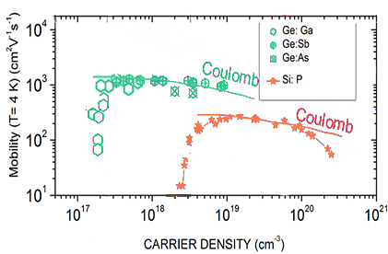
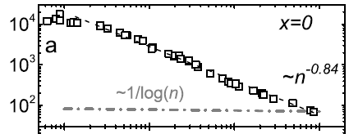
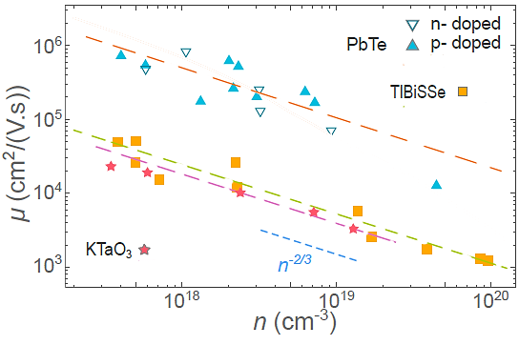
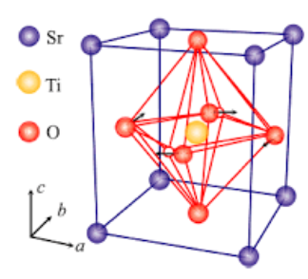
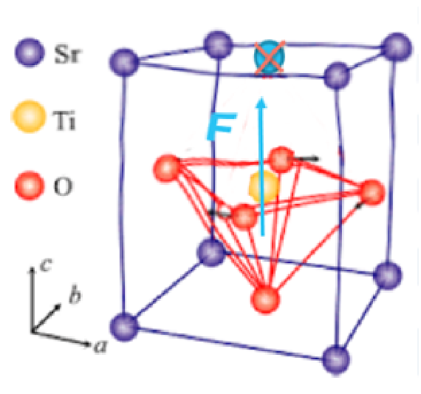
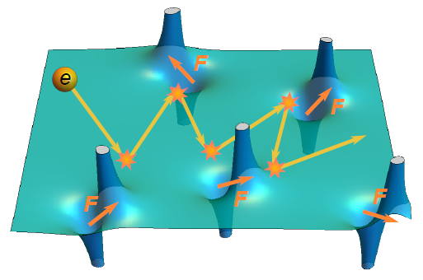
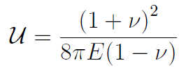
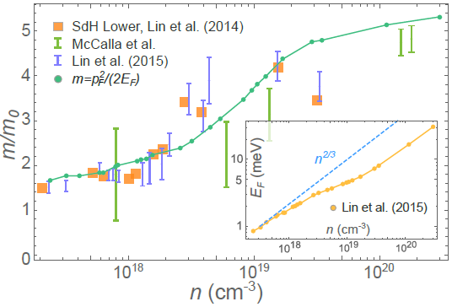
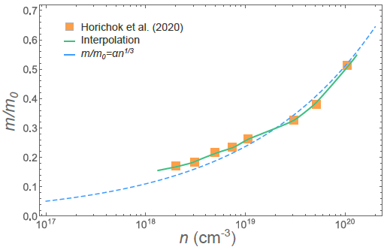
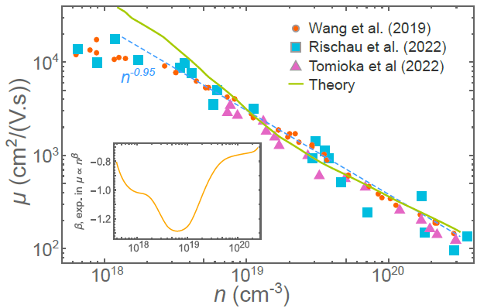
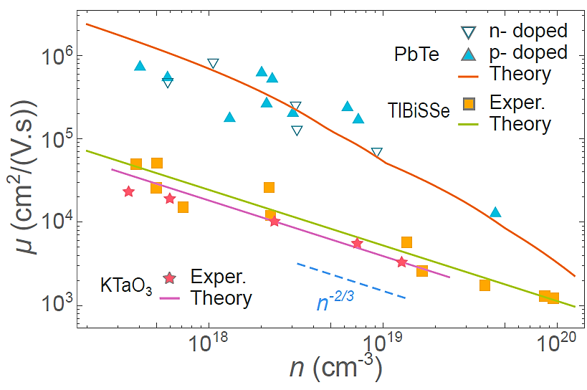
Low-temperature electron mobility in doped semiconductors with high dielectric constant
Kh. G. Nazaryan¹, and M.V. Feigel’man²
¹Department of Physics, Massachusetts Institute of Technology, Cambridge, MA 02139
²L. D. Landau Institute for Theoretical Physics, Russia
Conventional semiconductors
Semiconductors with high $ε$
v
Doping – Band insulators and semiconductors can be doped
v
Materials with high dielectric constant $ε$
(1) ${SrTiO}_{3}$, $ε=20000;$
(2) Wide gap: $KTaO_{3}$, $ε=4500$;
(3) Narrow gap: $PbTe$, $ε=1000$;
(4) Mixed-chalcogenide: $TlBiSSe$, $ε=20$
v
Mobility depends on the doping
Most conventional semiconductors feature $μ∼\ln{n}$ dependence on doping concentration
Examples: $P$ doped $Si$, doped $Ge$
v
Coulomb potential is suppressed
Conventional theory overestimates mobility
v
Theory
The data is well described by Coulomb scattering:
Note: $ε∼5$ for $Si$.
v
Power-law dependence for mobility
(2)-(4) mobility scales as $μ∝n^{−2/3}$
(1) mobility scales as $μ∝n^{−0.9}$
$$∝ε^{2}\ln{n}\text{.}$$
v
Problem
Need to find a novel scattering mechanism to describe the data
“Vector” impurities
Electron mobility
v
Local vector force
Atomic defect breaks the lattice’s symmetry, analogous to the presence of a frozen local vector force $F$
v
Deformation potential
Electrons interact with the deformation
potential, similar to el-ph interaction:
v
Elastic deformation
This local force $F$ deforms the elastic media around.
The elastic deformation field is found to be:
v
Boltzmann equation
Solve Boltzmann eq. with collision integral, describing above interaction
v
Elastic deformation
The forces are oriented isotropically.
The magnitude $\left|F\right|$ is our single fitting parameter.
v
Mobility
$$∝m^{−2}\left(n\right) n^{−2/3}$$
Application to $SrTiO_{3−x}$
Application to other materials
v
Effective mass
We replace the Fermi surface with an effective spherical one, with a phenomenological isotropic mass
v
Effective mass
For $PbTe$ we found the effective mass m(n)
For $KTaO_{3} −m=0.5m_{0},$
For $TlBiSSe m=0.14m_{0}$
v
Results
The theory describes the experiment well for $n>5⋅{10}^{18} {cm}^{−3}$
Both the scaling and magnitude
v
Results
Theory agrees with the experiment.
Both the scaling and magnitude
v
Fitting parameter
We determined the value of $|F|$
v
Deformation magnitude
We estimate the deformation scale with respect to the lattice spacing $a$
Conclusions
References
v
New scattering mechanism
Introduced a new scattering mechanism based on vector impurities. The model contains a single fitting parameter
K. G. Nazaryan, M. V. Feigel'man, SciPost Phys. 14, 046 (2023)
K. Behnia, J. Phys.:Condens. Matter 27, 375501 (2015)
J. Wang, L. Yang, C. W. Rischau, Z. Xu, Z. Ren, T. Lorenz, J. Hemberger, X. Linand K. Behnia npj Quantum Mater. 4, 61 (2019)
C. W. Rischau, D. Pulmannova, G. W. Scheerer, A. Stucky, E. Giannini and D. van der Marel, Phys. Rev. Res. 4,013019 (2022)
Y. Tomioka, N. Shirakawa and I. H. Inoue, npj Quantum Mater. 7, 111 (2022)
E. McCalla, M. N. Gastiasoro, G. Cassuto, R. M. Fernandes and C., Phys. Rev. Mater. 3, 022001 (2019)
X. Lin, G. Bridoux, A. Gourgout, G. Seyfarth, S. Kramer, M. Nardone, B. Fauque andK. Behnia, Phys. Rev. Lett. 112, 207002 (2014)
X. Lin, B. Fauqué and K. Behnia, Science 349, 945 (2015)
I. V. Horichok and T. O. Parashchuk, J. Appl. Phys.127, 055704 (2020)
v
Applicability to a broad class of materials
The theory is applicable to a broad range of materials with large dielectric constant
v
Good agreement with experimental data
The theoretical predictions agree with the experiment. Both the scaling and magnitude
The research was supported by Russian Science Foundation (grant No. 21-12-00104)

